Slide 1

Online Shopping data Analysis
Jeongwon Yoo

Slide 2
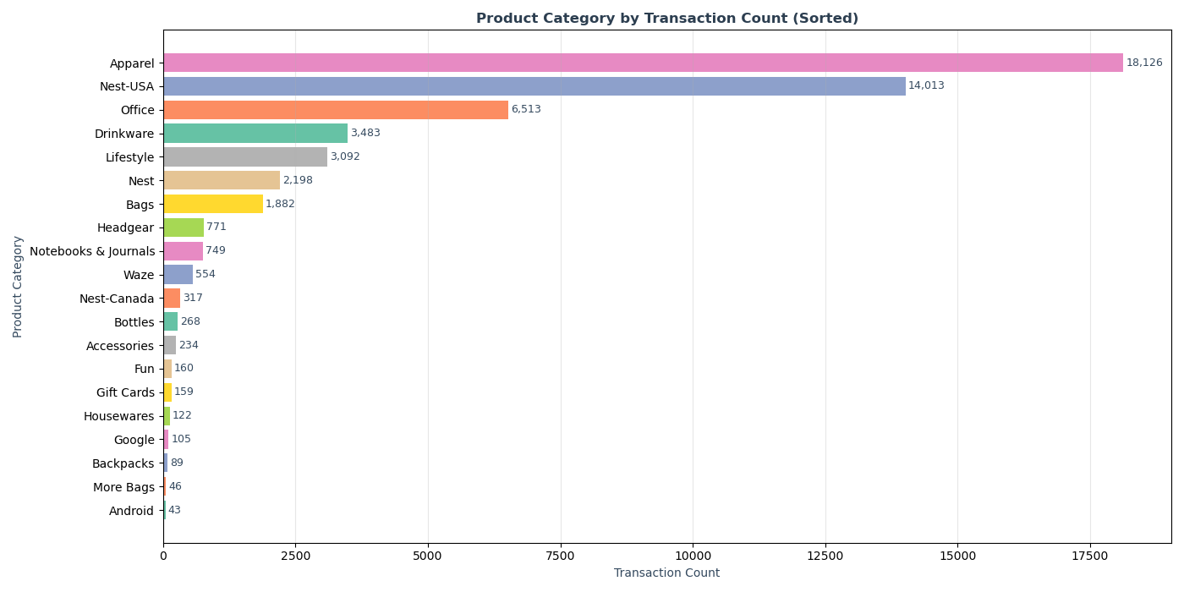
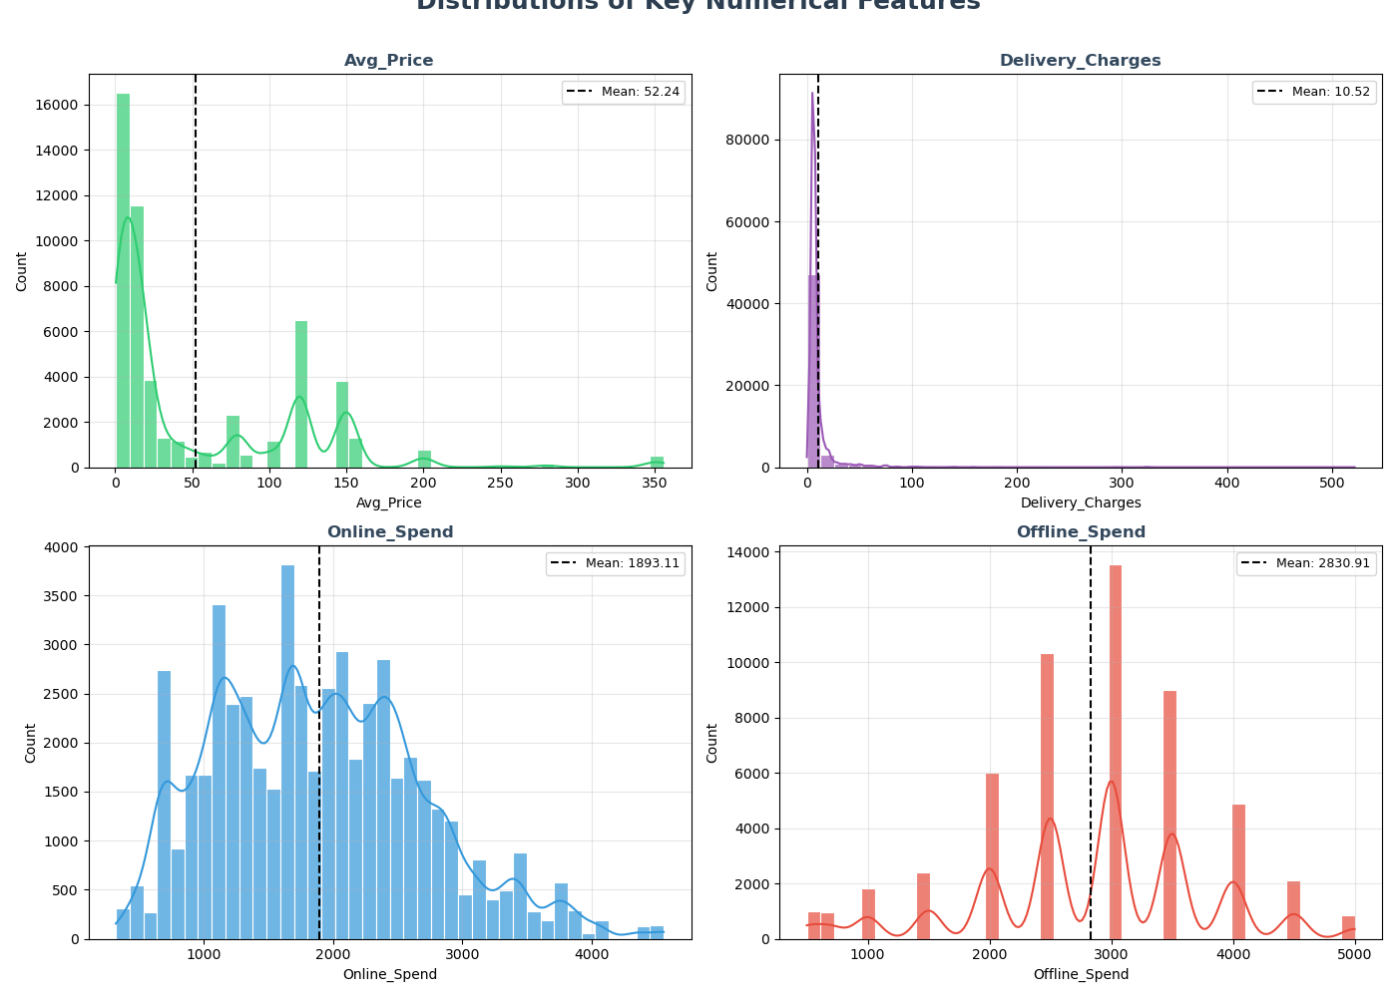
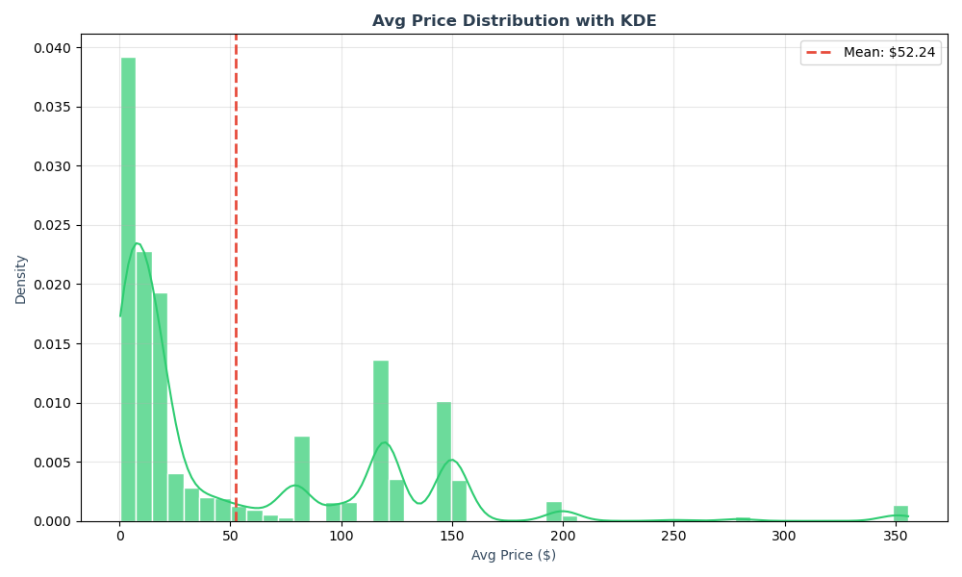
Apparel dominates with 18,126 transactions, followed by Nest-USA (14,013). Niche categories like Notebooks/Android have very few transactions.
Avg Price is heavily right-skewed (mean=$52.24). Most products priced under $50 with a long tail to $350+.
Avg_Price & Delivery_Charges are right-skewed. Online_Spend & Offline_Spend show more uniform distributions.

Slide 3
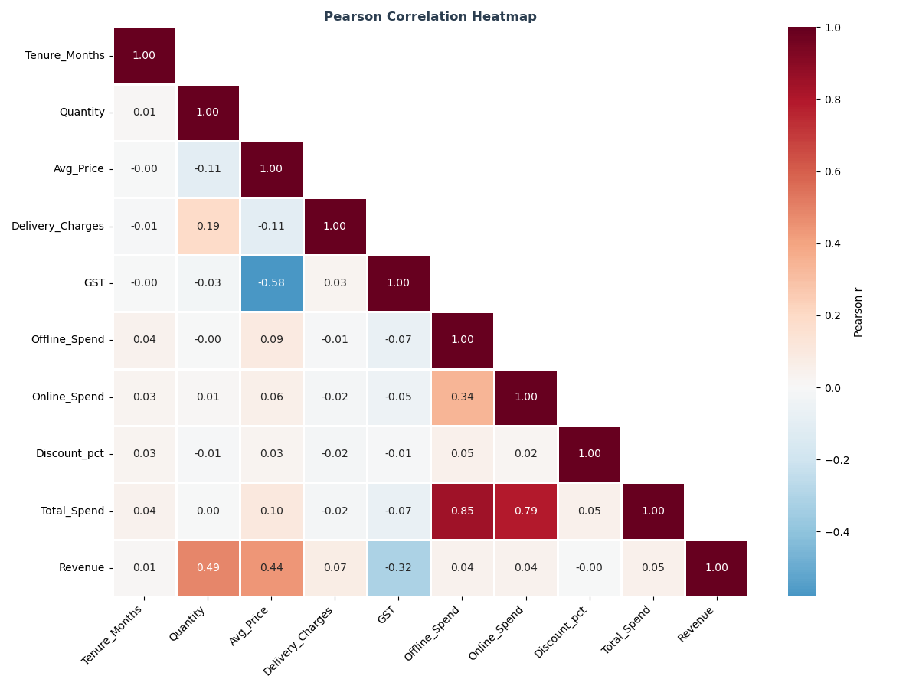
Revenue strongly correlates with Quantity (r=0.49) and Avg_Price (r=0.44). Total_Spend is driven by Offline_Spend (r=0.85) and Online_Spend (r=0.79). GST shows a notable negative correlation with Avg_Price (r=-0.58). Most other feature pairs show weak or no correlation.

Slide 4
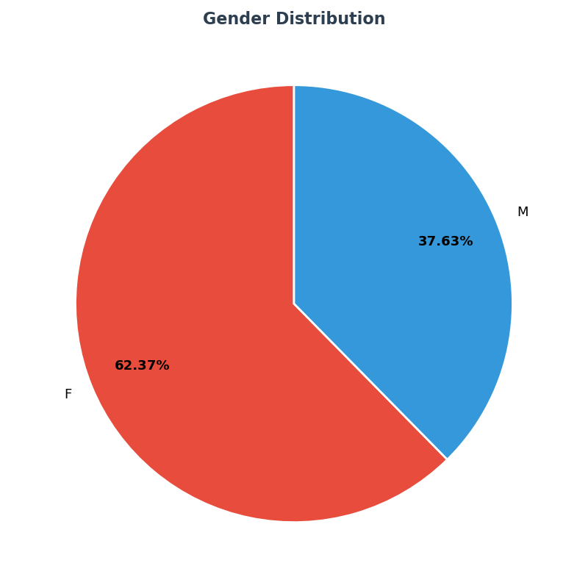
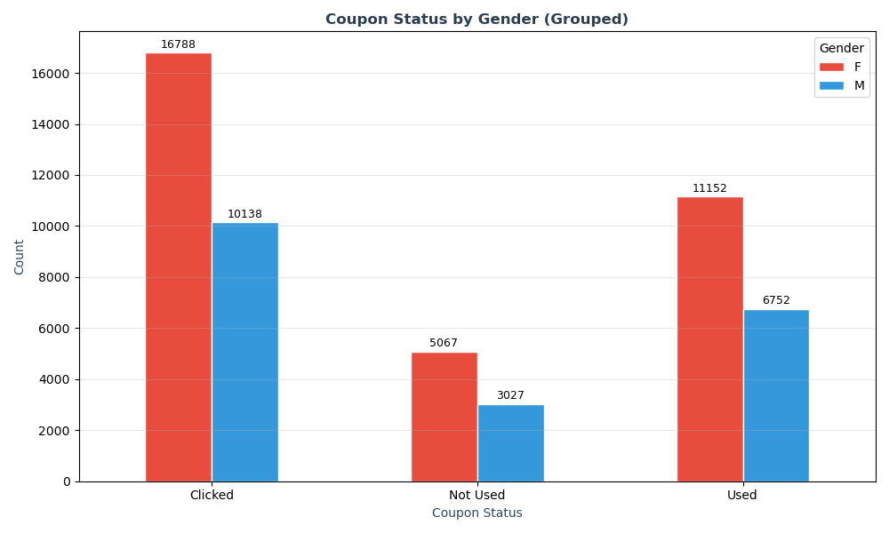
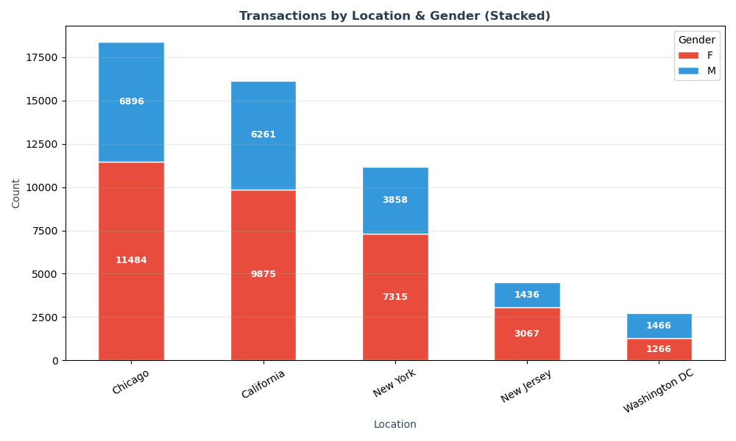
'Clicked' is the most common coupon status for both genders. Females dominate all coupon categories.
Female customers represent 62.37% of all transactions, nearly a 2:1 ratio over males.
Chicago leads with 18,380 transactions, followed by California (16,136). Female customers outnumber males in every location.

Slide 5
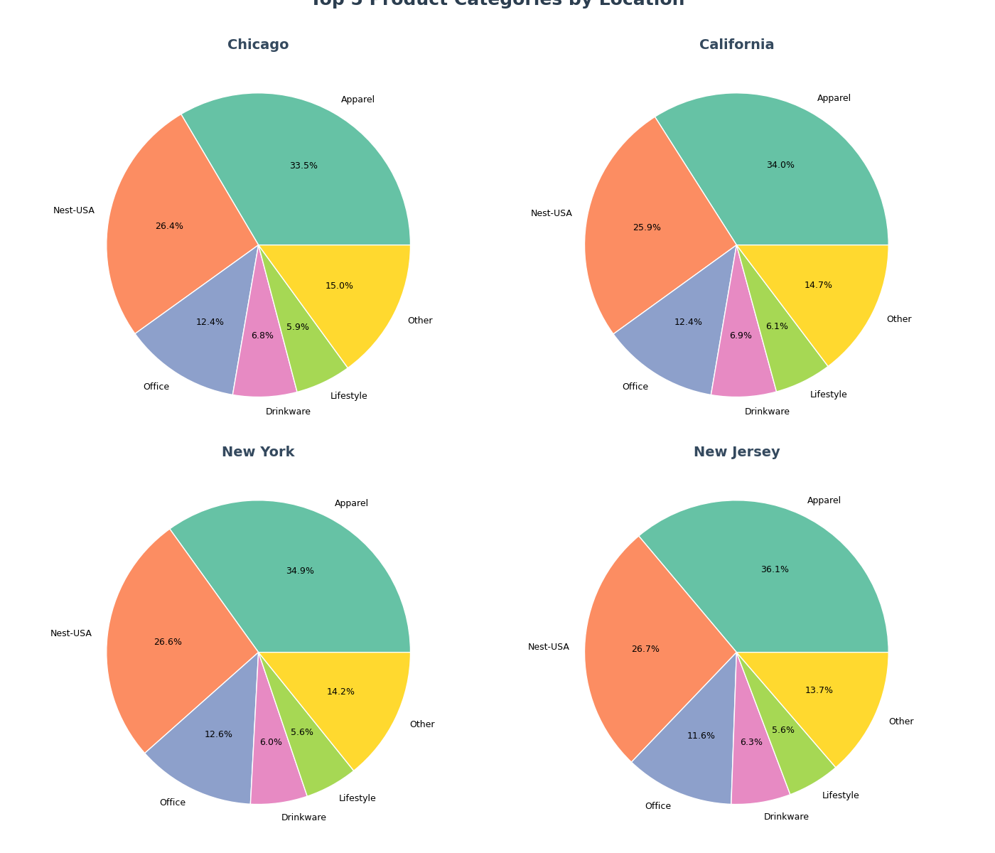
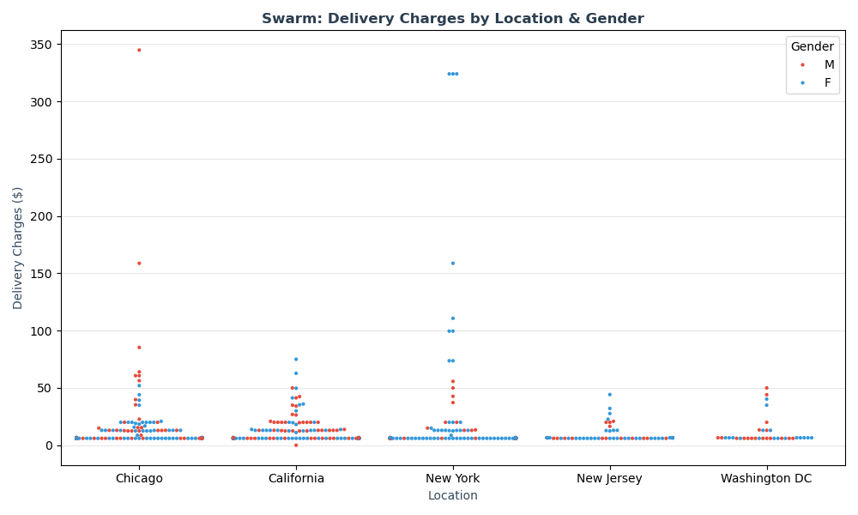
Apparel is #1 category in all 4 cities (33-36%). Category mix is remarkably consistent across locations, no strong regional preference.
Delivery charges range $0-$50 across all locations with a few outliers up to $350. No significant location or gender difference in delivery charges.

Slide 6
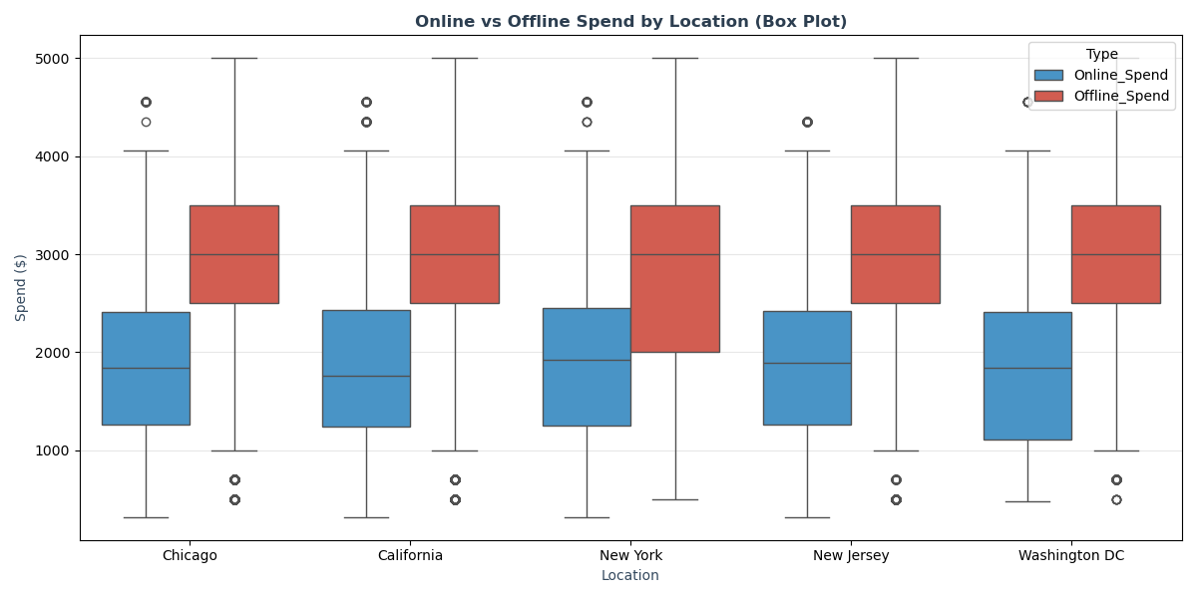
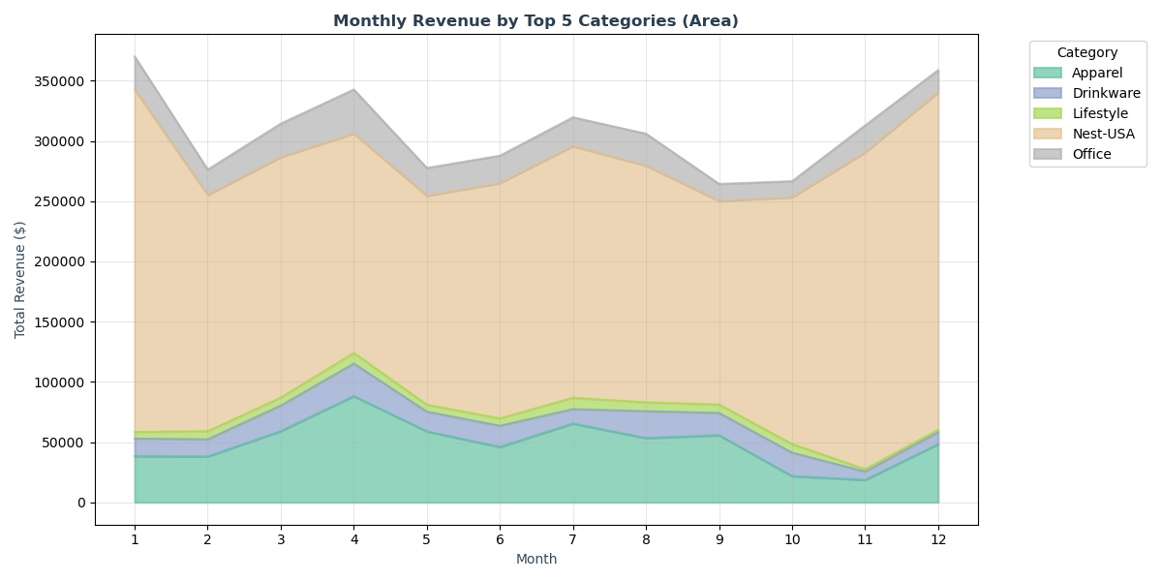
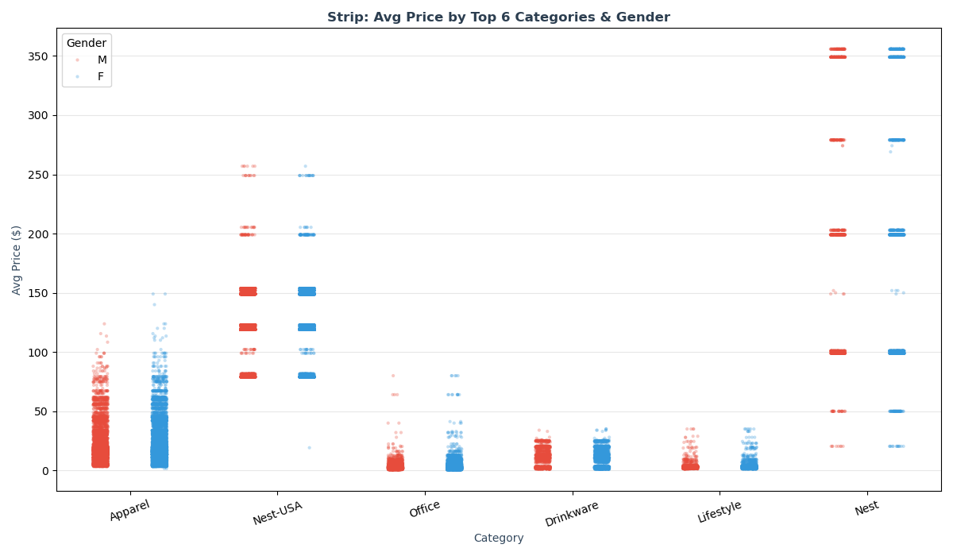
Offline spend has a higher median and wider IQR than online spend across all locations. Distributions are remarkably similar across cities.
Nest-USA generates the highest monthly revenue. Seasonal peaks visible around months 8-10 for most categories.
Nest-USA has the widest price range ($0-$350). Apparel, Office, and Drinkware are concentrated under $50.

Slide 7
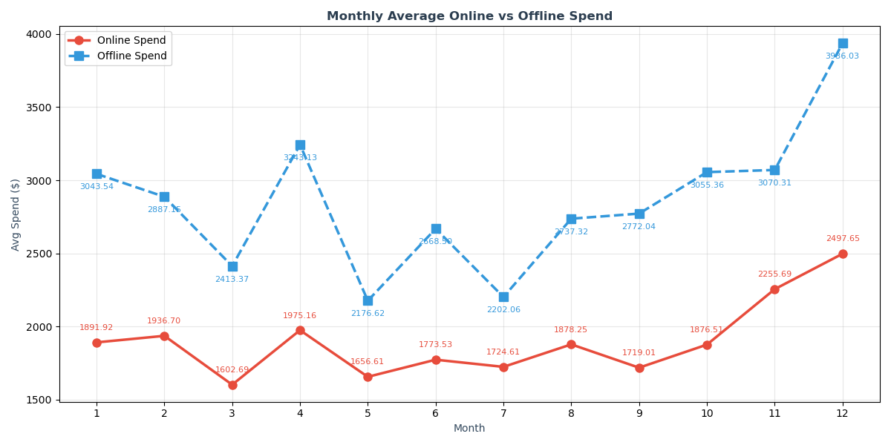
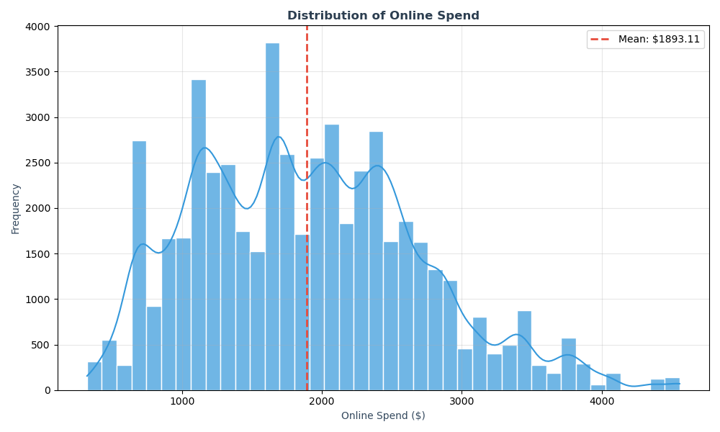
Offline spend is consistently higher than online spend. Offline peaks in months 4, 5, and 11. Online spend remains relatively stable (~$1,600-$2,500).
Online spend is roughly uniformly distributed between ~$320-$4,557. Mean = $1,893.11.

Slide 8
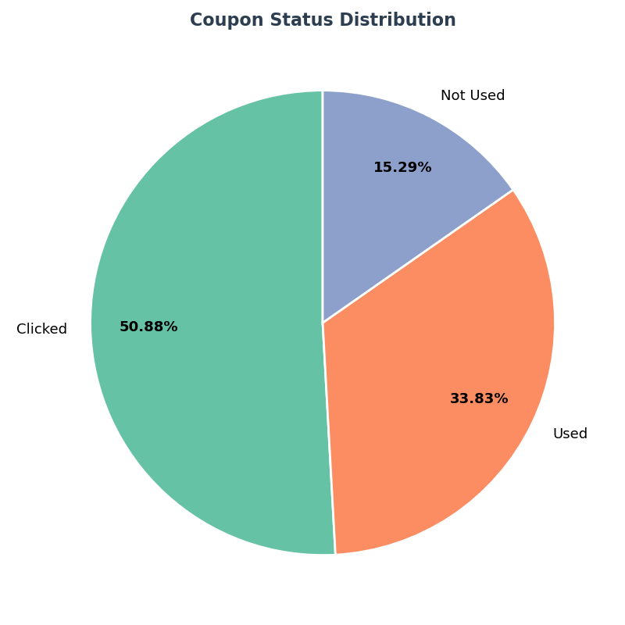
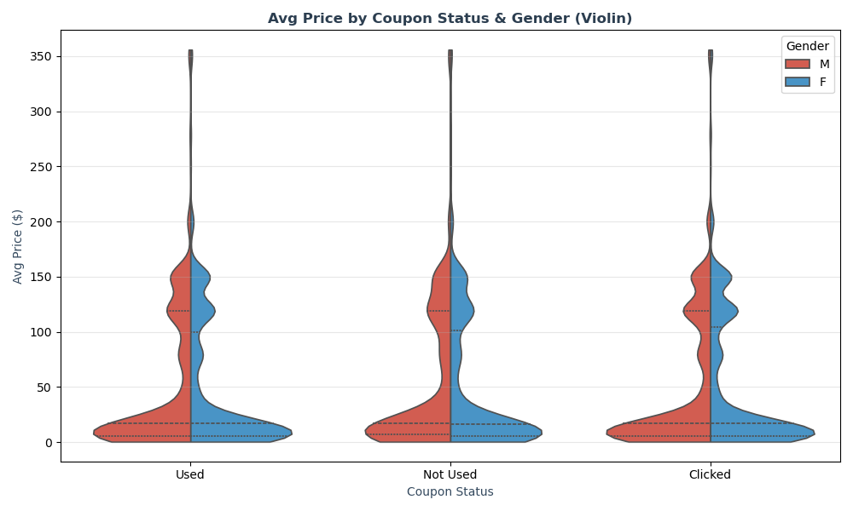
50.88% of coupons were clicked but not redeemed. Only 33.83% were actually used. 15.29% were not engaged with at all.
Price distributions are heavily right-skewed across all coupon statuses. Most products priced under $50. No significant difference in pricing between genders or coupon usage groups.

